Slide 1


Analysis & Design Project
Group 5:
Anusha Kokkinti- 01856785
Neeharika Gopala- 01834758
Sultan Alasfour- 01789817
OMIS 651: Systems Analysis and Design
Instructor: Dr. Onkar S. Malgonde

Slide 2
Overview
Existing system
Proposed system
Requirement Specification Techniques
User Interface Principles
Acquisition strategy
Test Cases
Conclusion: Transition to New system

Slide 3
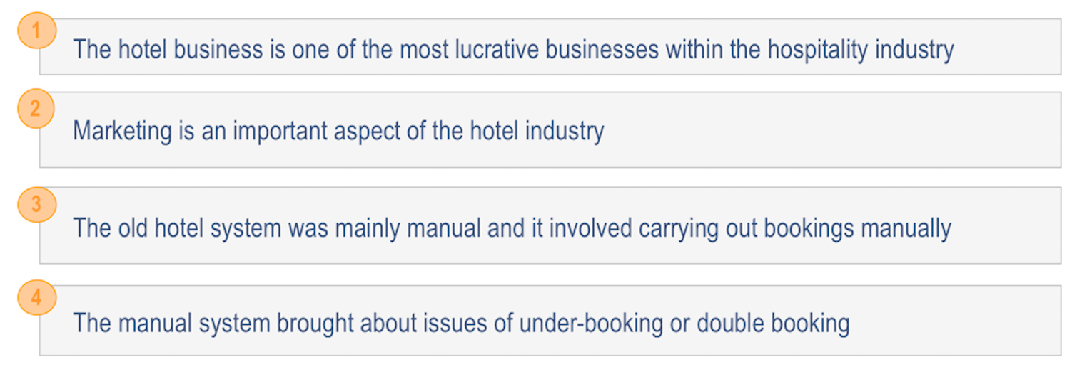
Existing system

Slide 4
Proposed system
Hassle-free management of bookings
Smarter insights into business
Increase revenues

Slide 5
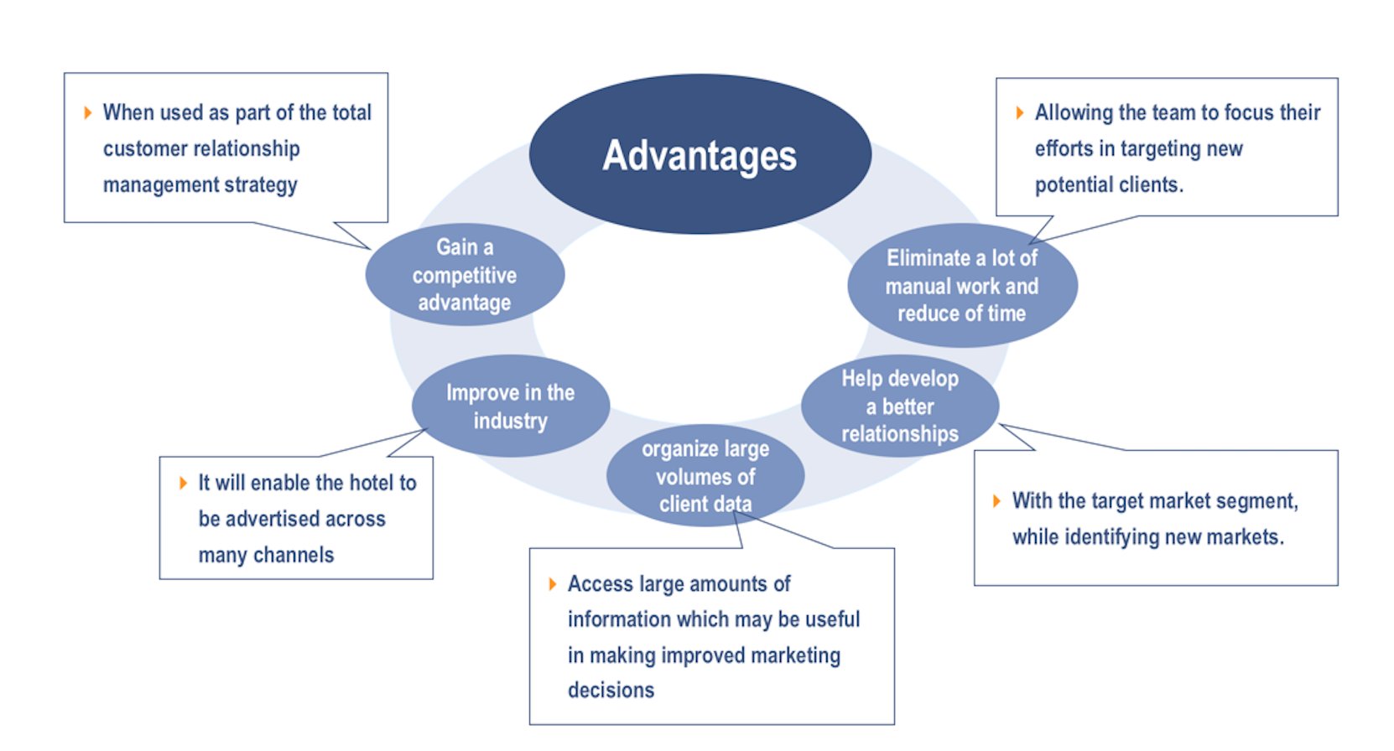
Advantages of the proposed system

Slide 6
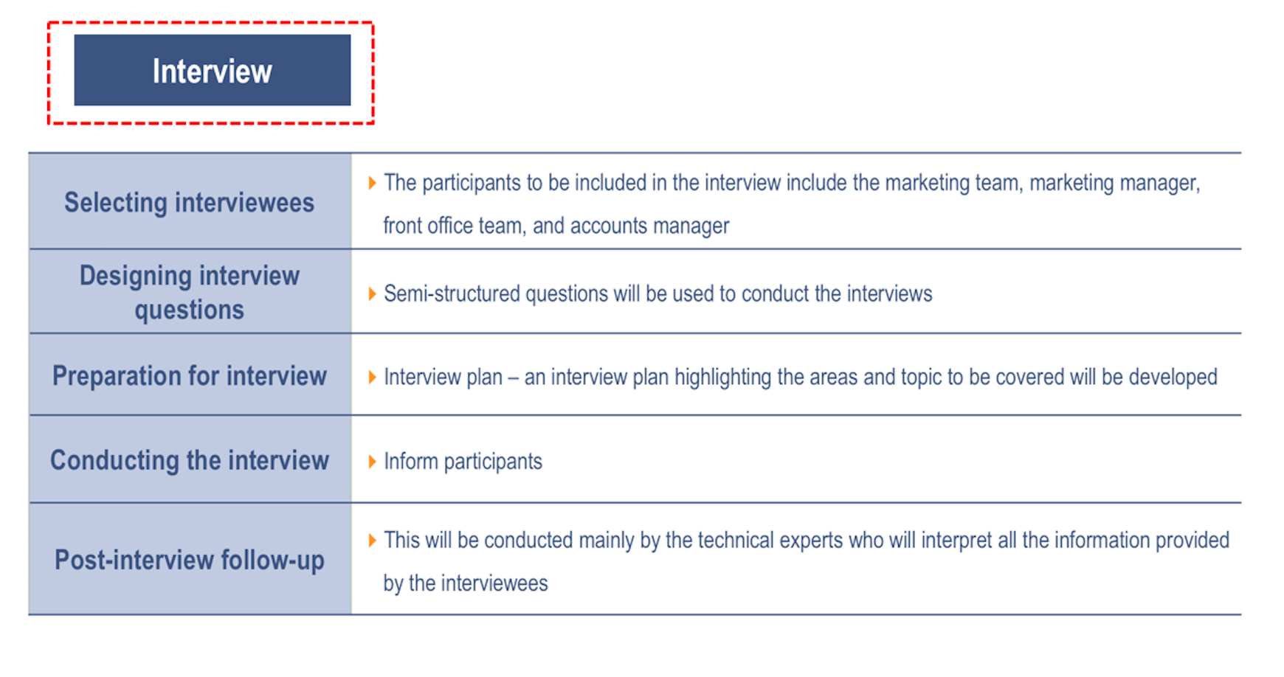
Requirement Specification Techniques

Slide 7
Agile Approach
Hospitality industry needs constant upgradation to align with
evolving market demands
Agile is apt to use when business needs are frequently changing
and believes in concepts like
Team work
Quick response to change
Better Customer Collaboration

Slide 8
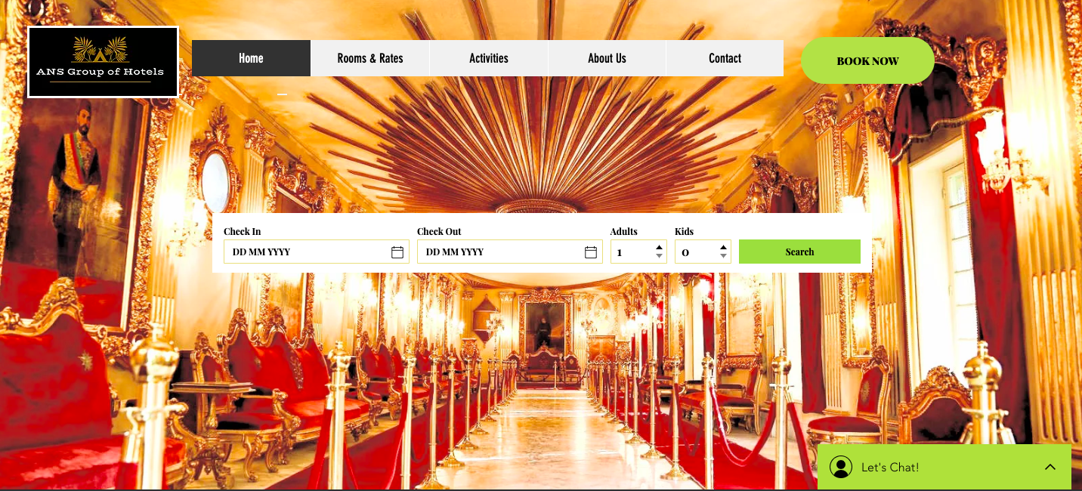
User Interface

Slide 9
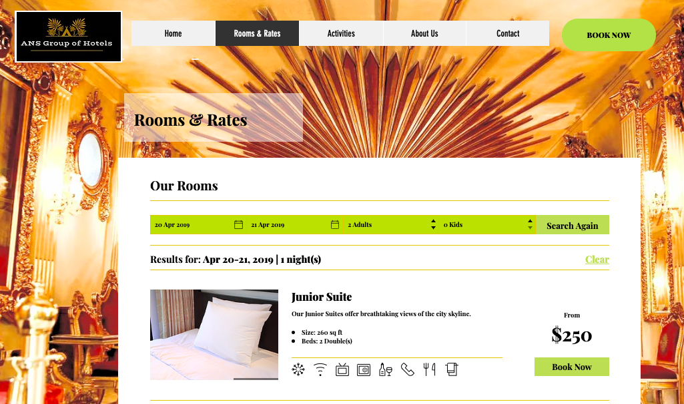
User Interface

Slide 10
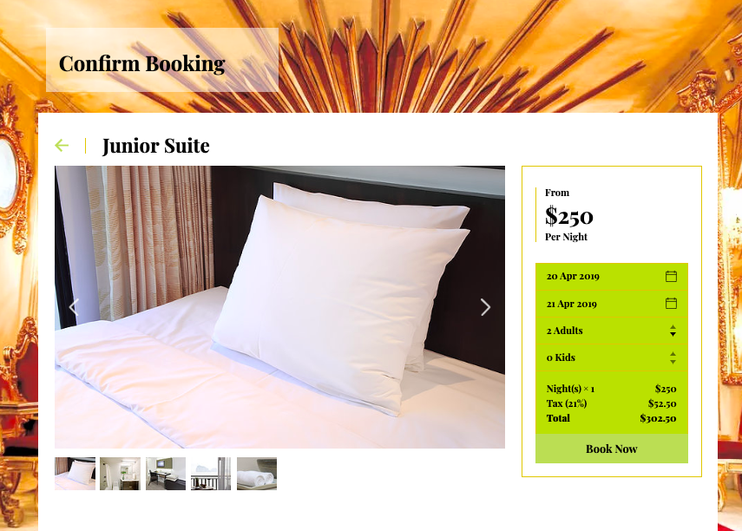
User Interface

Slide 11
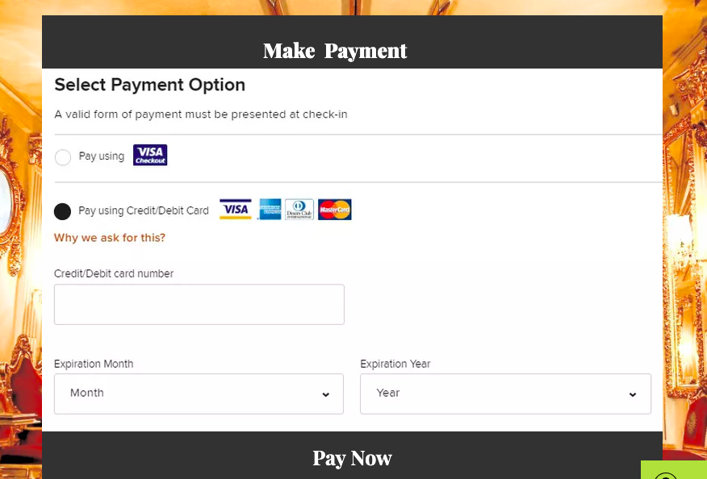
User Interface

Slide 12
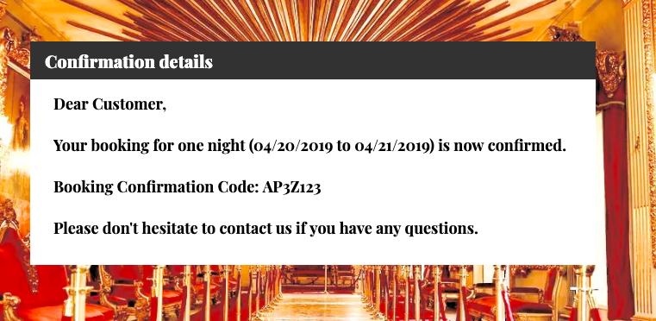
User Interface

Slide 13
Acquisition Strategy
Packaged Software – Cloudbeds
Cloudbeds serves as an all-in-one hotel management system with real-time
Improved Efficiency
Increased Productivity
Centralized Management
Less Overall Cost

Slide 14
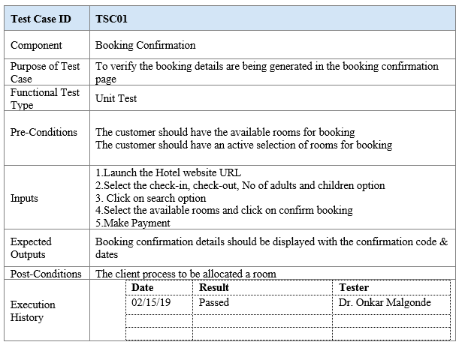
Test Cases

Slide 15
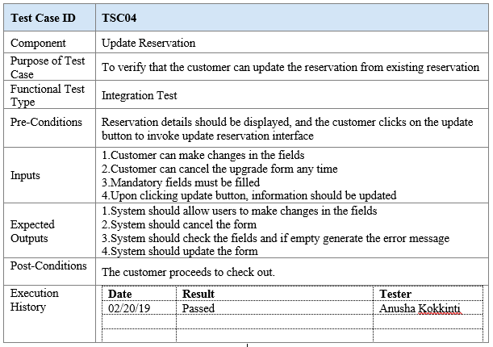
Test Cases

Slide 16
Conclusion : Transition to New System
A modular transition style will be employed, with each sales region shifting to the new system in modules or in stages, one after the other
The transition to the new hotel reservation system is expected to contribute towards effective management of data and records in the hotel

Slide 17
Thank You !

